Slide 1
Talking Points
Define Project Constraints:
List of Hardware
List of Wanted Sensors
List of Wanted HUD Information

Slide 2
Talking Points
Main Project Tasks
  Physical Hardware Setup
    Heads Up Display Unit
    Computing Unit
    Make and Model of Mask
    Power Source
HUD GUI
Per-Unit
Networking
Sensors

Slide 3
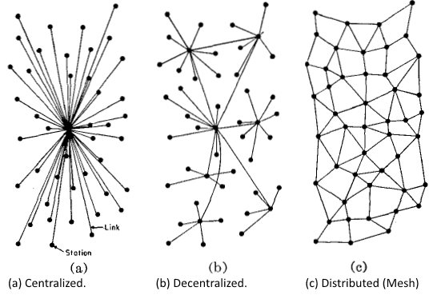
Talking Points
Main Project Tasks
  Communication Code
    Networking Method (Centralized, Decentralized, Mesh)
    Internet Connection? (Offline Map Data?)

Slide 4
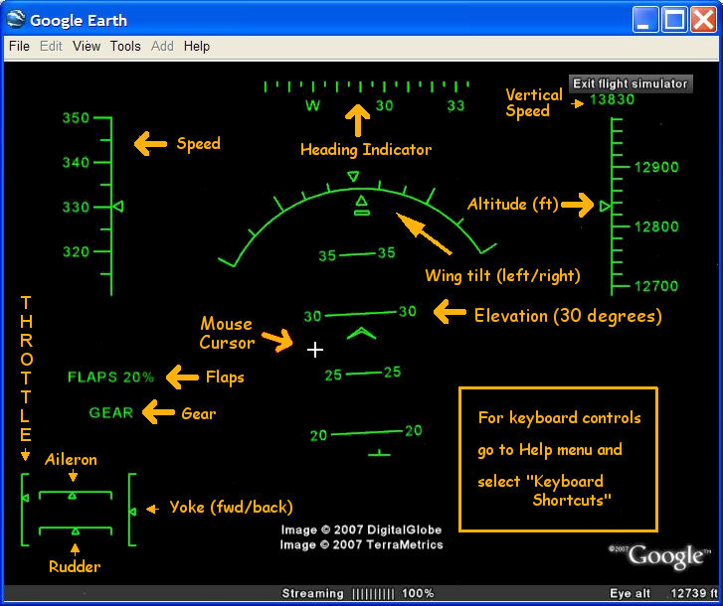
Talking Points
Main Project Tasks
  Sensor Handling Code
    Jitter Smoothing
    Direction of Travel Derivation
    GPS + Acc. Combined Position/Direction Algorithm
    Environment Light Intensity Sensor (Night vs Day HUD)

Slide 5
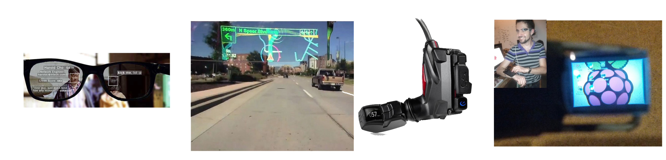
Talking Points
Main Project Tasks
  GUI Code
    Handle Night vs Day HUD Color Pallet
    SketchUp GUI Pre-Code Design Assistance
    Minimize Distraction
    Maximize Information

Slide 6
Talking Points
Ski Goggle Interior Clearance: 2.3cm = 7/8 inch
 | Mini-LCD | Augmented Vision
Display Device | + Cheep, Flexible - Space, Eye Angle | + Space, Flexible, Eye-Angle - Expensive, Scarce
API Device | + Built-in Sensors - Space, Eye Angle, API-Limited, Expensive | + Built-in Sensors, Eye-Angle - API-Limited, Expensive, Scarce

